Slide 1
MEAN REVERSION TRADING ON VOLATILITY ASSETS

Slide 2
What is Mean Reversion?
A simple definition
Our intuition on Mean Reversion
Why consider Mean Reversion?
For diversification purposes
The main drivers are known
Implied volatility focus: How to trade Mean Reversion on VIX?
How to illustrate mean reversion on VIX?
A statistical approach to design a mean reversion strategy on VIX

Slide 3


A simple definition
Mean Reversion is a key property of financial assets
It characterizes the ability for an underlying asset to revert towards an average value after unusual moves away from that value:
-Extreme spikes are likely to be followed by drops
-Very sharp drops are likely to be followed by bullish runs

Slide 4
Our intuition on Mean Reversion
10Y VIX historical average value has been around 21 for the past 10 years
VIX well above 21 could be viewed as ‘expensive’
VIX well below 21 could be viewed as ‘cheap ’
The observation window matters
Source: Natixis Financial Engineering, using Bloomberg Data
US Equity Implied Volatility

Slide 5
Our intuition on Mean Reversion
The JCJ Index is a CBOE measure of the implied correlation of the S&P 500 components through S&P 500 option prices
Average implied correlation has been around 61 for the past 2 years
JCJ Index well above 61 could be viewed as ‘expensive’
JCJ Index well below 61 could be viewed as ‘cheap’
Source: Natixis Financial Engineering, using Bloomberg Data
US Equity Implied Correlation

Slide 6
Our intuition on Mean Reversion
The VIX Index can be viewed as a proxy of 1M Variance swap price
Average carry has been positive, around +3.3 points for the past 10 years
A carry well above 3.3 could be viewed as ‘expensive’
A carry well below 3.3 could be viewed as ‘cheap’
Source: Natixis Financial Engineering, using Bloomberg Data
S&P 500 variance swap carry

Slide 7
Our intuition on Mean Reversion
The average realized variance swap spread between DAX Index and Eurostoxx 50 has been around -1 point for the past 10 years
A spread well above -1 could be viewed as ‘expensive’
A carry well below -1 could be viewed as ‘cheap’
Source: Natixis Financial Engineering, using Bloomberg Data
Variance swap spreads

Slide 8
What is Mean Reversion?
A simple definition
Our intuition on Mean Reversion
Why consider Mean Reversion?
For diversification purposes
The main drivers are known
Implied volatility focus: How to trade Mean Reversion on VIX?
How to illustrate mean reversion on VIX?
A statistical approach to design a mean reversion strategy on VIX

Slide 9






Diversification benefits
North America
S&P 500 Index – cap weighted index
NASDAQ 100 Index – modified cap weighted index
RUSSEL 2000 Index – cap weighted index
Europe
EUROSTOXX 50 Index – cap weighted index
FTSE 100 Index – cap weighted index
SMI index – cap weighted index
Asia
TOPIX Index – cap weighted index
HANG SENG Index – cap weighted index
HSCEI Index – cap weighted index
Most equity benchmarks are market cap weighted and thus follow a trend following behavior

Slide 10
Diversification benefits
Market cap weighted indices can become overweight in some particular sector because of performance
Exposure to financial bubbles can therefore be significant
Mean Reversion may help to mitigate negative effects of speculative bubble bursts
Tech bubble
Housing bubble
Source: Natixis Financial Engineering, using Bloomberg Data
Potential diversification issues on market cap weighted indices

Slide 11
The main drivers of mean reversion
Imbalance between offer and demand
Liquidity drought can often link to under or over valuation levels
Correlation is high between VIX major spikes and VIX futures liquidity
Short-squeeze effects
Over / under supply consequences (e.g. on commodities)
General market participants behavior
Herd / trend following behavior of market participants often link to an amplification of the movements (e.g. bubbles)
Source: Natixis Financial Engineering, using Bloomberg Data
Some drivers can be identified

Slide 12
The main drivers of mean reversion
Arbitrage
Hedge funds, proprietary traders, and arbitragers
Attractiveness of asymmetric trades (“easy money” to be made relatively quickly)
Common beliefs often becomes self fulfilling
Implied assets:
Implied correlation trades range bound between -1 and +1
Implied volatility, skew, term structure, and vol of vol are regarded as mean reverting
Some assets are ‘believed’ to be mean reverting

Slide 13
What is Mean Reversion?
A simple definition
Our intuition on Mean Reversion
Why consider Mean Reversion?
For diversification purposes
The main drivers are known
Implied volatility focus: How to trade Mean Reversion on VIX?
How to illustrate mean reversion on VIX?
A statistical approach to design a mean reversion strategy on VIX

Slide 14
How to trade Mean Reversion on VIX ?
The VIX Index reflects the short term implied volatility of the S&P 500:
The CBOE Volatility Index (VIX) is a key measure of market expectations of near-term volatility conveyed by S&P 500 stock index option prices.
The VIX Index spikes in bearish market environments:
VIX is known as the “fear gauge”
Put option hedging flows on S&P 500 index increase in bearish markets
The street increases its long implied volatility exposure
The VIX Index has a relatively low level in quiet or bullish markets
Less hedging flows in quiet or bullish markets
The street increases its short implied volatility exposure
Source: Natixis Financial Engineering, using Bloomberg Data
How to illustrate VIX Mean Reversion?

Slide 15
How to trade Mean Reversion on VIX ?
Upside Mean Reversion:
How often did the VIX Index close above its highest closing value of the month ?
Once closing above its monthly highest value, how many consecutive days did the VIX continue to close above its previous value ?
Downside Mean Reversion:
How often did the VIX Index close below its lowest closing value of the month ?
Once closing below its monthly lowest value, how many consecutive days did the VIX continue to close below its previous value ?
Source: Natixis Financial Engineering, using Bloomberg Data
How to illustrate VIX Mean Reversion?

Slide 16
How to trade Mean Reversion on VIX ?
Since January 1990:
The VIX Index closed its 1m-high approximately 7% of the time
Once above its 1m-high, the VIX Index closed above that value for an average period of 1.68 days before moving back down
The VIX Index has never moved up by more than 25 points during those above periods
Source: Natixis Financial Engineering, using Bloomberg Data
An illustration of upside mean reversion behavior

Slide 17
How to trade Mean Reversion on VIX ?
Since January 1990:
The VIX Index closed below its 1m-low approximately 11% of the time
Once below its 1m-low, the VIX Index closed below that value for an average period of 1.76 days before moving back up
The VIX Index has never moved down by more than 8 points during those above periods
Source: Natixis Financial Engineering, using Bloomberg Data
An illustration of downside mean reversion behavior

Slide 18
How to trade Mean Reversion on VIX?
The VIX is not an investable index
Selection of the best proxy of the VIX
VIX Future contracts are the best proxy of VIX Index
The first nearby contract exhibits the highest sensitivity to the VIX index
Source: Natixis Financial Engineering, using Bloomberg Data
The first VIX future contract may be the best VIX proxy

Slide 19
How to trade Mean Reversion on VIX?
Selection of the most liquid underlying
VIX Future contracts are the best proxy of VIX Index
The first nearby contract is much more liquid than following contracts
Source: Natixis Financial Engineering, using Bloomberg Data
The first VIX future contract may be the best VIX proxy

Slide 20
How to trade Mean Reversion on VIX?
An Illustration of the Mean Reversion of the first rolled VIX future contracts
Since January 1990:
The first VIX future rolled contract quoted (at the close of VIX index) above 1m-high approximately 7% of the time
Once above 1m-high, the first VIX future rolled contract stayed (at the close of VIX index) above that value for an average period of 1.93 days before moving back down
The first VIX future rolled contract Index has never moved up by more than 70% during those above periods
Source: Natixis Financial Engineering, using Bloomberg Data
Illustration of upside mean reversion of the first rolled VIX future contract

Slide 21
How to trade Mean Reversion on VIX?
An Illustration of the Mean Reversion of the first rolled VIX future contracts (“UX1”)
Since January 1990:
The first VIX future rolled contract quoted (at the close of VIX index) below its 1m-low approximately 22 % of the time
Once below its 1m-low, the first VIX future rolled contract stayed (at the close of VIX index) below that value for an average period of 2.25 days before moving back up
The first VIX future rolled contract Index has never moved down by more than 21% during those above periods
Source: Natixis Financial Engineering, using Bloomberg Data
Illustration of downside mean reversion of the first rolled VIX future contract

Slide 22
How to trade Mean Reversion on VIX?
Basic mean reversion strategy:
We have identified the first rolled VIX future contracts as a good proxy of the VIX index
We have identified the first rolled VIX future contracts as a mean reverting underlying
Basic systematic investment strategy:
Buy variance swap with daily observations against variance swaps with weekly observations on the first rolled VIX future contract
In theory: product is worth 0 but it pays in case of effective mean reversion of the underlying
Daily cap of the delta exposure at 100% in absolute terms
For liquidity issues, replicate the above strategy using delta component only
Step 1: construction of a basic systematic Mean Reversion Strategy

Slide 23
How to trade Mean Reversion on VIX?
The historical performance of the basic mean reversion strategy is not attractive
The contango has a significant impact on the strategy
Need for timing in order to capture more value
Source: Natixis Financial Engineering, using Bloomberg Data
Step 1: construction of a basic systematic Mean Reversion Strategy

Slide 24
How to trade Mean Reversion on VIX?
Statistical approach of when mean reversion is relevant on the first VIX future contract:
Simulation of 10 systematic sub-strategies per observation window
Each sub-strategy :
Systematically implements the basic mean reversion strategy on a daily basis if the rolled first VIX future falls between one predefined percentile at the close of the VIX index
10 sub-strategies corresponding to 10 percentiles (<=10%, ]10%-20%],…, ]80%-90%],>=90%)
4 Observation windows considered: 1 month, 3 months, 6 months and 12 month
Total number of strategy is 40 (10 sub-strategies for a given observation window)
Step 2: A systematic approach based on statistics

Slide 25
How to trade Mean Reversion on VIX?
SUMMARY OF RESULTS OF THE 10 SUB-STRATEGIES WITHIN A 1 MONTH WINDOW
On a 1 month window the sub systematic strategy invested only on the [40%-50%] percentile would historically limit more the contango effect
Mean Reversion would have been hurt more in the <10% percentile sub-strategy
One month window is not historically an attractive one
Percentile | Internal rate of return (IRR) | Realised Volatility (Vol) | IRR/vol | Maximum Drawdown | Beta | Trade Proportion
<= 10% | -24.86% | 25.31% | (0.98) | -96.47% | (0.31) | 40%
[10%-20%] | -7.27% | 13.96% | (0.52) | -57.21% | (0.09) | 10%
[20%-30%] | -9.44% | 10.98% | (0.86) | -67.00% | (0.02) | 6%
[30%-40%] | -4.70% | 9.48% | (0.50) | -48.70% | 0.02 | 6%
[40%-50%] | -0.23% | 7.11% | (0.03) | -26.61% | (0.01) | 5%
[50%-60%] | -4.42% | 8.72% | (0.51) | -43.59% | 0.01 | 4%
[60%-70%] | -3.52% | 11.10% | (0.32) | -37.41% | 0.03 | 5%
[70%-80%] | -0.87% | 10.14% | (0.09) | -19.85% | 0.06 | 4%
[80%-90%] | -2.29% | 12.33% | (0.19) | -38.37% | 0.11 | 5%
> 90% | -9.55% | 34.63% | (0.28) | -78.50% | 0.65 | 14%
Source: Natixis Financial Engineering, using Bloomberg Data
Step 2: A systematic approach based on statistics – 1 month window

Slide 26
How to trade Mean Reversion on VIX?
HISTORICAL SIMULATION OF THE BEST AND WORST SUB-STRATEGIES WITHIN A 1 MONTH WINDOW
Source: Natixis Financial Engineering, using Bloomberg Data
Step 2: A systematic approach based on statistics – 1 month window

Slide 27
How to trade Mean Reversion on VIX?
SUMMARY OF RESULTS OF THE 10 SUB-STRATEGIES WITHIN A 3 MONTHS WINDOW
On a 3 months window the sub systematic strategy invested only on the [20%-30%] percentile would historically perform better on a risk return basis
Mean Reversion would have been hurt more on the <10% percentile sub-strategy
Percentile | Internal rate of return (IRR) | Realised Volatility (Vol) | IRR/vol | Maximum Drawdown | Beta | Trade Proportion
<= 10% | -24.58% | 27.50% | (0.89) | -95.77% | (0.33) | 46%
[10%-20%] | -4.81% | 12.01% | (0.40) | -54.85% | 0.01 | 10%
[20%-30%] | 5.97% | 11.50% | 0.52 | -17.15% | 0.01 | 6%
[30%-40%] | -6.20% | 11.14% | (0.56) | -53.28% | (0.01) | 5%
[40%-50%] | -4.29% | 11.67% | (0.37) | -45.01% | 0.02 | 5%
[50%-60%] | -14.53% | 15.46% | (0.94) | -82.05% | 0.08 | 4%
[60%-70%] | -3.83% | 9.17% | (0.42) | -42.22% | 0.02 | 4%
[70%-80%] | 2.91% | 10.37% | 0.28 | -18.55% | 0.03 | 5%
[80%-90%] | 0.43% | 10.95% | 0.04 | -30.31% | 0.03 | 5%
> 90% | -9.56% | 30.43% | (0.31) | -79.88% | 0.57 | 10%
Source: Natixis Financial Engineering, using Bloomberg Data
Step 2: A systematic approach based on statistics – 3 months window

Slide 28
How to trade Mean Reversion on VIX?
HISTORICAL SIMULATION OF THE BEST AND WORST SUB-STRATEGIES WITHIN A 3 MONTHS WINDOW
Source: Natixis Financial Engineering, using Bloomberg Data
Step 2: A systematic approach based on statistics – 3 months window

Slide 29
How to trade Mean Reversion on VIX?
SUMMARY OF RESULTS OF THE 10 SUB-STRATEGIES WITHIN A 6 MONTHS WINDOW
On a 6 month window the sub systematic strategy invested only on the [10%-20%] percentile would have historically performed better on a risk return basis and offered a good diversification
Mean Reversion would have been hurt more in the <10% percentile sub-strategy
Percentile | Internal rate of return (IRR) | Realised Volatility (Vol) | IRR/vol | Maximum Drawdown | Beta | Trade Proportion
<= 10% | -22.76% | 28.93% | (0.79) | -94.68% | (0.26) | 49%
[10%-20%] | 1.34% | 13.84% | 0.10 | -20.20% | 0.02 | 9%
[20%-30%] | -10.45% | 16.44% | (0.64) | -70% | 0.06 | 7%
[30%-40%] | -4.01% | 10.68% | (0.38) | -41.48% | 0.00 | 5%
[40%-50%] | -3.81% | 15.46% | (0.25) | -39.00% | 0.07 | 5%
[50%-60%] | 0.41% | 15.50% | 0.03 | -30.14% | 0.05 | 4%
[60%-70%] | -0.65% | 10.61% | (0.06) | -31.02% | (0.01) | 5%
[70%-80%] | -5.55% | 10.86% | (0.51) | -52.94% | 0.06 | 4%
[80%-90%] | -4.32% | 10.79% | (0.40) | -43.71% | 0.05 | 4%
> 90% | -5.30% | 24.36% | (0.22) | -69.57% | 0.40 | 8%
Source: Natixis Financial Engineering, using Bloomberg Data
Step 2: A systematic approach based on statistics – 6 months window

Slide 30
How to trade Mean Reversion on VIX?
HISTORICAL SIMULATION OF THE BEST AND WORST SUB-STRATEGIES WITHIN A 6 MONTHS WINDOW
Source: Natixis Financial Engineering, using Bloomberg Data
Step 2: A systematic approach based on statistics – 6 months window

Slide 31
How to trade Mean Reversion on VIX?
SUMMARY OF RESULTS OF THE 10 SUB-STRATEGIES WITHIN A 12 Months WINDOW
On a 12 months window the sub systematic strategy invested only on the [30%-40%] percentile would have historically performed better on a risk return basis and offered a good diversification
Mean Reversion would have been hurt more from a risk return perspective on the [40%-50%] percentile sub-strategy
Percentile | Internal rate of return (IRR) | Realised Volatility (Vol) | IRR/vol | Maximum Drawdown | Beta | Trade Proportion
<= 10% | -14.37% | 30.25% | (0.47) | -85.42% | (0.16) | 48%
[10%-20%] | -11.93% | 19.63% | (0.61) | -73.71% | 0.05 | 13%
[20%-30%] | -9.24% | 21.16% | (0.44) | -62% | 0.13 | 9%
[30%-40%] | 6.93% | 12.31% | 0.56 | -27.51% | 0.03 | 6%
[40%-50%] | -11.00% | 13.01% | (0.85) | -69% | 0.04 | 4%
[50%-60%] | -7.05% | 15.12% | (0.47) | -61.06% | 0.08 | 2%
[60%-70%] | 4.53% | 12.61% | 0.36 | -15.09% | 0.03 | 3%
[70%-80%] | 3.55% | 10.87% | 0.33 | -23.80% | (0.02) | 5%
[80%-90%] | -9.20% | 12.10% | (0.76) | -63.12% | 0.05 | 6%
> 90% | -2.75% | 15.41% | (0.18) | -56.82% | 0.23 | 5%
Source: Natixis Financial Engineering, using Bloomberg Data
Step 2: A systematic approach based on statistics – 12 months window

Slide 32
How to trade Mean Reversion on VIX?
HISTORICAL SIMULATION OF THE BEST AND WORST SUB-STRATEGIES WITHIN A 12 MONTHS WINDOW
Source: Natixis Financial Engineering, using Bloomberg Data
Step 2: A systematic approach based on statistics – 12 months window

Slide 33
How to trade Mean Reversion on VIX?
SUMMARY: SOME DIVERSIFICATION AMONG THE 4 SUB-STRATEGIES SHORT LISTED
1 month window: mean reversion applied to the [40%-50%] percentile
3 months window: mean reversion applied to the [20%-30%] percentile
6 months window: mean reversion applied to the [10%-20%] percentile
12 months window: mean reversion applied to the [30%-40%] percentile
Mean reversion on implied volatility have been a very risky strategy in very high or very low volatility environment
3 months and 12 months windows have historically been the best windows
-Historical correlation matrix
 | MR 0.3-0.4 12m Window | MR 0.1-0.2 6m Window | MR 0.2-0.3 3m Window | MR 0.4-0.5 1m Window
MR 0.3-0.4 12m Window | 100.00% | -0.07% | 1.53% | 3.05%
MR 0.1-0.2 6m Window | -0.07% | 100.00% | 53.60% | 0.67%
MR 0.2-0.3 3m Window | 1.53% | 53.60% | 100.00% | 1.86%
MR 0.4-0.5 1m Window | 3.05% | 0.67% | 1.86% | 100.00%
Source: Natixis Financial Engineering, using Bloomberg Data
Step 3: taking advantage of the intra diversification

Slide 34
How to trade Mean Reversion on VIX?
FINAL SYSTEMATIC MEAN REVERSION STRATEGY: EQUALLY WEIGHTED AMONG THE 4 SUB-STRATEGIES
1 month window: mean reversion applied to the [40%-50%] percentile
3 months window: mean reversion applied to the [20%-30%] percentile
6 months window: mean reversion applied to the [10%-20%] percentile
12 months window: mean reversion applied to the [30%-40%] percentile
Source: Natixis Financial Engineering, using Bloomberg Data
Step 3: building the final mean reversion strategy on VIX

Slide 35
How to trade Mean Reversion on VIX?
FINAL SYSTEMATIC MEAN REVERSION STRATEGY: EQUALLY WEIGHTED AMONG THE 4 SUB-STRATEGIES
1 month window: mean reversion applied to the [40%-50%] percentile
3 months window: mean reversion applied to the [20%-30%] percentile
6 months window: mean reversion applied to the [10%-20%] percentile
12 months window: mean reversion applied to the [30%-40%] percentile
AN ILLUSTRATIVE EXAMPLE OF SYSTEMATIC MEAN REVERSION STRATEGY ON IMPLIED VOLATILITY BASED ON A STATISTICAL APPROACH
Source: Natixis Financial Engineering, using Bloomberg Data
Step 3: building the final mean reversion strategy on VIX

Slide 36
How to trade Mean Reversion on VIX?
ILLUSTRATIVE FINAL SYSTEMATIC MEAN REVERSION STRATEGY: EQUALLY WEIGHTED AMONG THE 4 SUB-STRATEGIES
Good performance can occur in both bullish and bearish market environments on Mean Reversion strategy
Source: Natixis Financial Engineering, using Bloomberg Data
Step 3: building the final mean reversion strategy on VIX

Slide 37
How to trade Mean Reversion on VIX?
ILLUSTRATIVE FINAL SYSTEMATIC MEAN REVERSION STRATEGY: EQUALLY WEIGHTED AMONG THE 4 SUB-STRATEGIES
Poor performance can occur in both bullish and bearish market environments on Mean Reversion strategy
Source: Natixis Financial Engineering, using Bloomberg Data
Step 3: building the final mean reversion strategy on VIX

Slide 38
How to trade Mean Reversion on VIX?
Source: Natixis Financial Engineering, using Bloomberg Data
Equal weight basket between the S&P 500 and the final mean reversion strategy

Slide 39
Customizable Volatility Screener
Adding value for our clients
We have a customizable volatility screener that helps clients visualize trends in volatility
When a client shares their portfolio holdings with us (after signing an NDA), we can run internal reports to determine where vol is ‘cheap’ and where vol is ‘expensive’ relative to its sector and its single stock/ETF history
This can aid in mean reversion strategies and other volatility plays

Slide 40
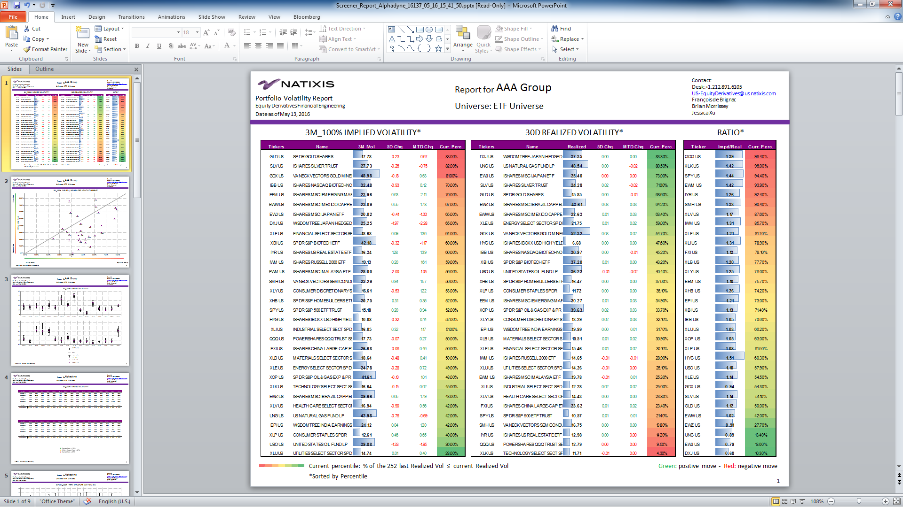
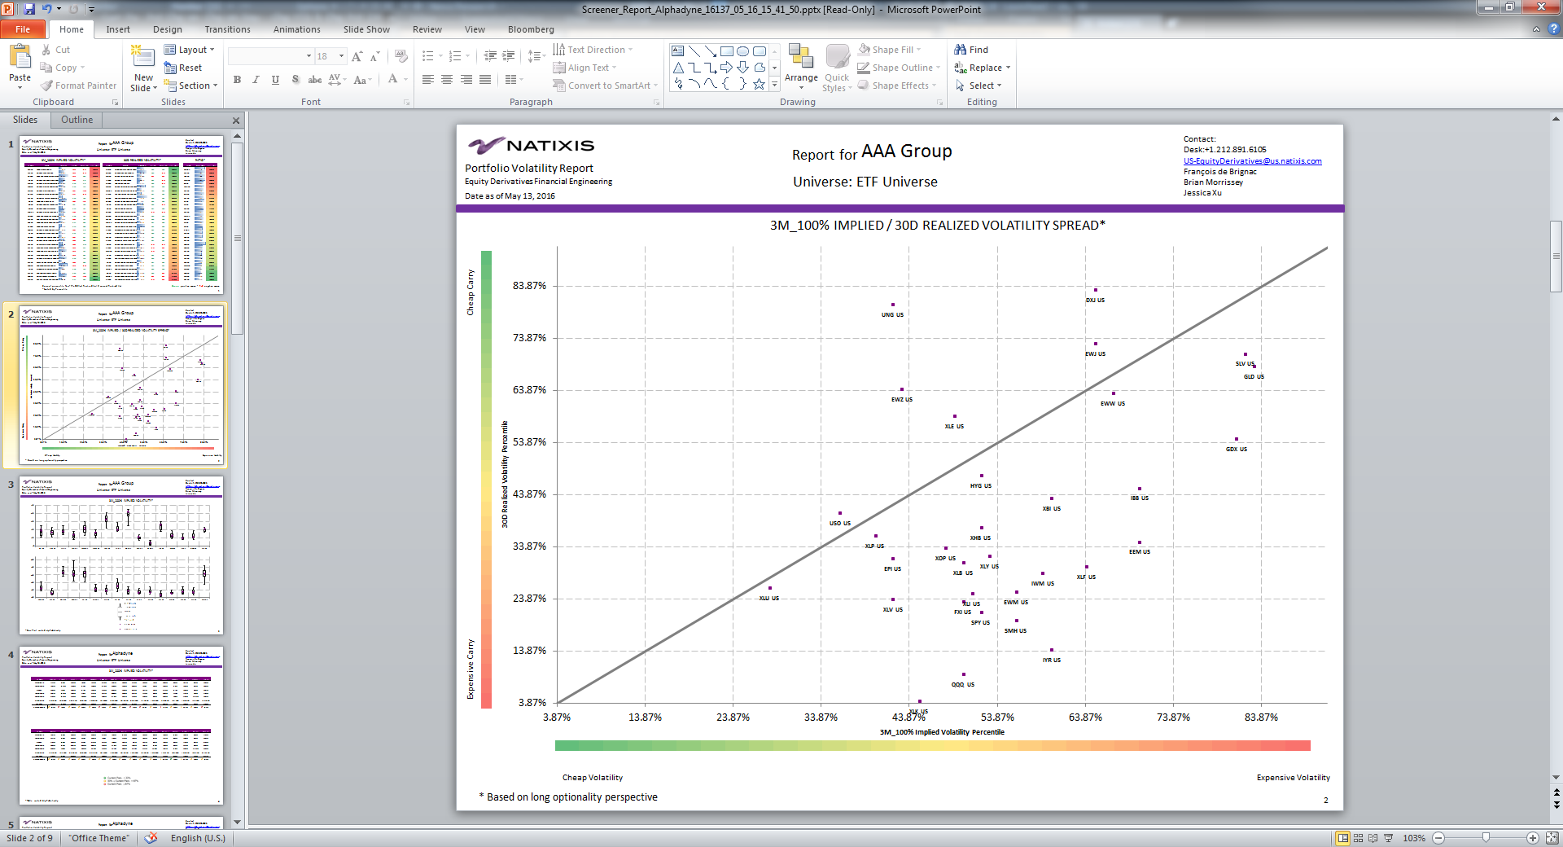
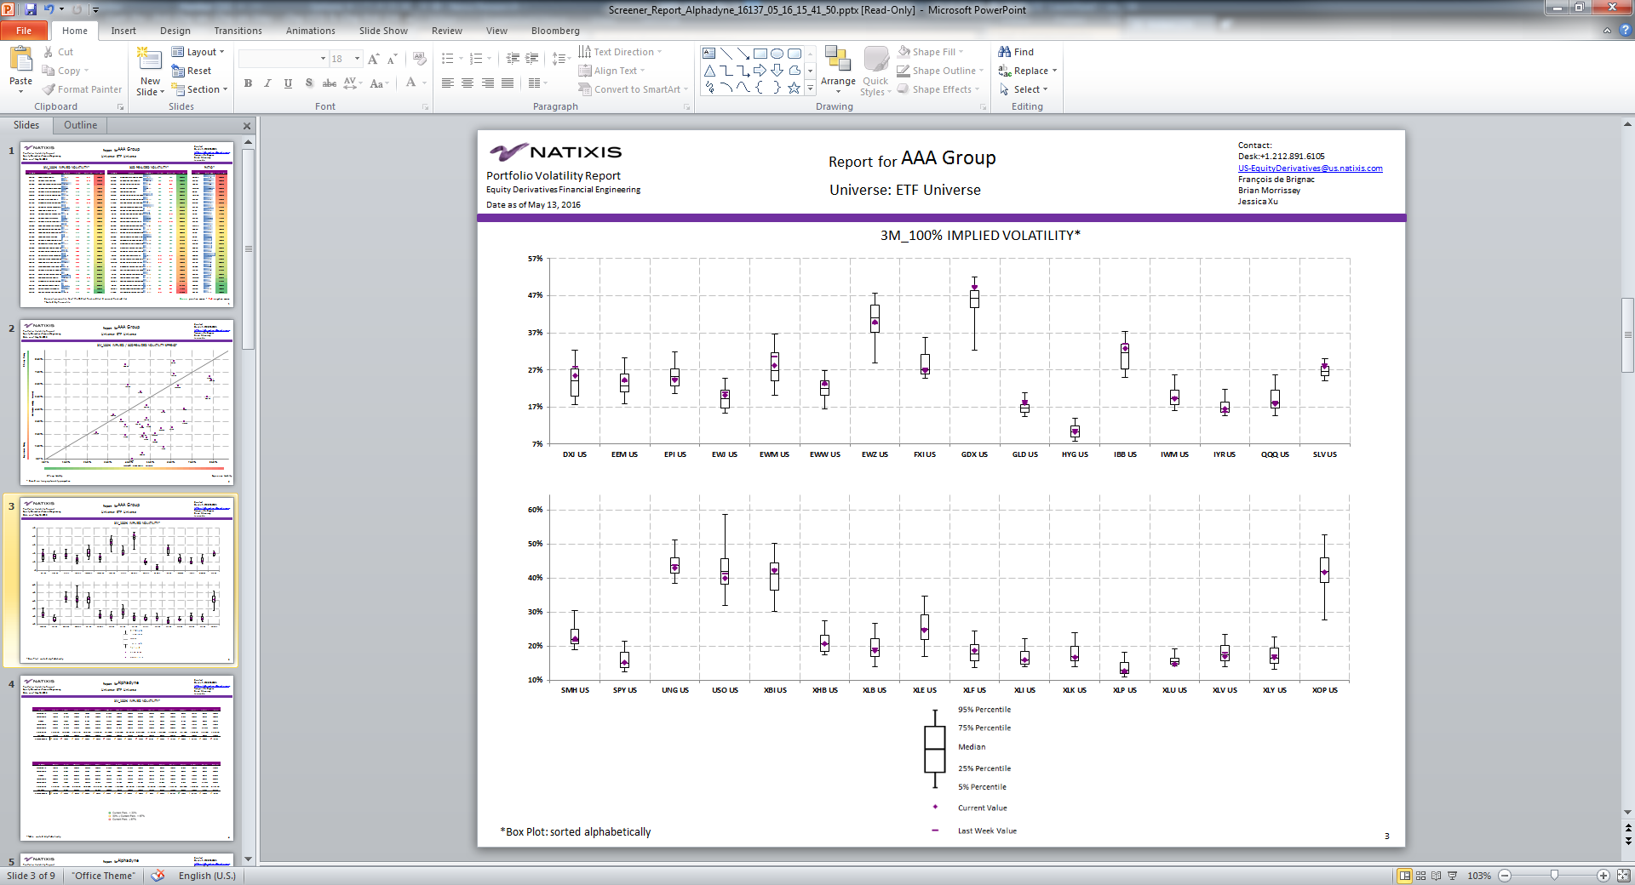
Customizable Volatility Screener

Slide 41
Conclusion
Questions?

Slide 42

Contacts
Sam Rosenberg Fabrice Tenga Francois de Brignac Brian Morrissey
W: 212-891-5768 W. 212-891-5744 W. 212-698-3044 W. 212-891-6177
samuel.rosenberg@us.natixis.com fabrice.tenga@us.natixis.com francois.debrignac@us.natixis.com brian.morrissey@us.natixis.com
1251 Avenue of the Americas
New York, NY 10020
US-EquityDerivatives@us.natixis.com

Slide 43
Disclaimer
This preliminary information (“Preliminary Information”) is for discussion and information purposes only. It is highly confidential and it is the property of Natixis, acting through its New York Branch (together with its affiliates, collectively “Natixis”). It should not be transmitted to any person other than the original addressee or recipient without the prior written consent of Natixis. This Preliminary Information is a marketing presentation. It does not constitute an independent investment research and has not been prepared in accordance with the legal requirements designed to promote the independence of investment research. Accordingly there are no prohibitions on dealing ahead of its dissemination. The distribution, possession or delivery of this Preliminary Information in, to or from certain jurisdictions may be restricted or prohibited by law. Recipients of this Preliminary Information are therefore required to ensure that they are aware of, and comply with, such restrictions or prohibitions. Neither Natixis, nor any of its affiliates, directors, employees, agents or advisers nor any other person accept any liability to anyone in relation to the distribution, possession or delivery of this Preliminary Information in, to or from any jurisdiction. This Preliminary Information is communicated to each recipient for information purposes only and does not constitute a personalized recommendation. It is not intended for general distribution and the products described herein do not take into account any specific investment objective, financial situation or particular need of any recipient. It should not be construed as an offer or solicitation with respect to the purchase, sale or subscription of any interest or security or as an undertaking by Natixis to complete a transaction subject to the terms and conditions described in this Preliminary Information or any other terms and conditions. Any guarantee, funding, interest or currency swap, underwriting or more generally any undertaking provided for in this Preliminary Information should be treated as preliminary only and is subject to a formal approval and written confirmation in accordance with Natixis’ current internal procedures. Natixis may have a long or short position in or buy or sell any product or security mentioned herein. The products referenced herein are not suitable for all investors, they may involve a high degree of risk, may not be transferable and may not be listed or traded on any exchange. Please review the relevant disclosure documents and seek any advice that you consider necessary or desirable to obtain before buying or selling any of the referenced products. Natixis has neither verified nor independently analyzed the information contained in this Preliminary Information. Accordingly, no representation, warranty or undertaking, express or implied, is made to recipients as to or in relation to the accuracy or completeness or otherwise of this Preliminary Information or as to the reasonableness of any assumption contained in this Preliminary Information. The information contained in this Preliminary Information does not take into account specific tax rules or accounting methods applicable to counterparties, clients or potential clients of Natixis. Therefore, Natixis shall not be liable for differences, if any, between its own valuations and those valuations provided by third parties; as such differences may arise as a result of the application and implementation of alternative accounting methods, tax rules or valuation models. Prices and margins are deemed to be indicative only and are subject to changes at any time depending on, inter alia, market conditions. Past performance and simulations of past performance are not a reliable indicator and therefore do not predict future results. The information contained in this document may include results of analyses from a quantitative model, which represent potential future events that may or may not be realized, and is not a complete analysis of every material fact representing any product. Information may be changed or withdrawn by Natixis at any time without notice. More generally, no responsibility is accepted by Natixis, nor by any of its holding companies, subsidiaries, associated undertakings or controlling persons, or any of their respective directors, officers, partners, employees, agents, representatives or advisors as to or in relation to the characteristics of this information. The statements, assumptions and opinions contained in this Preliminary Information may be forward-looking and are therefore subject to risks and uncertainties. Actual results and developments may differ materially from those expressed or implied, depending on a variety of factors and accordingly there can be no guarantee of the projected results, projections or developments. Natixis makes no representation or warranty, expressed or implied, as to the accomplishment of or reasonableness of, nor should any reliance be placed on any projections, targets, estimates or forecasts, or on the statements, assumptions and opinions expressed in this Preliminary Information. Nothing in this Preliminary Information should be relied on as a promise or guarantee as to the future. It should not be assumed that the information contained in this Preliminary Information will have been updated subsequent to the date stated on the front page of this Preliminary Information. In addition, the delivery of this Preliminary Information does not imply in any way an obligation on anyone to update the information contained herein at any time. Natixis shall not be liable for any financial loss or any decision taken on the basis of the information contained in this Preliminary Information and Natixis does not hold itself out as providing any advice, particularly in relation to investment services. In any event, you should request any internal and/or external advice that you consider necessary or desirable to obtain, including any financial, legal, tax or accounting advice, or any other specialist advice, in order to verify in particular that the investment(s) described in this Preliminary Information meets your investment objectives and constraints, and to obtain an independent valuation of such investment(s), and the risk factors and rewards. This Preliminary Information is for qualified, knowledgeable and sophisticated institutional investor clients only. No further distribution is permitted. Distribution to retail investors is prohibited.

